Slide 1
Hypothermia in preterm infants
Dr TejoPratap Oleti
Consultant Neonatology,
Fernandez Hospital,
Hyderabad.

Slide 2
Objectives
Effect of hypothermia on mortality and morbidities
Thermal well being in preterm infants

Slide 3
Effect of hypothermia
Hypothermia
Hypoglycemia
Metabolic acidosis
Poor weight gain
Myocardial dysfunction
Shock
Neurological injuries
Hypoxia
Apneas
PPHN
Coagulopathy
Sepsis

Slide 4
Effect of low admission temperatures
For each drop in 1ºC
  Mortality – increases by 28%
  Late onset sepsis – 11%
Laptook et al. Pediatrics; 2007.

Slide 5
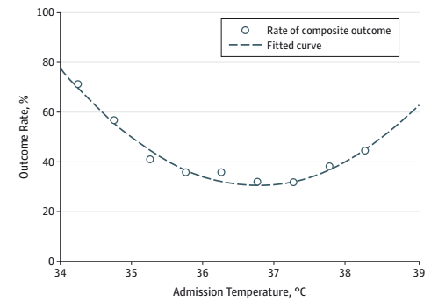
Admission temp – mortality/morbidities
Outcomes
  Mortality
  Severe Neurological injury
  Severe ROP
  BPD
  Late onset sepsis
  Ventilation
  Severe NEC
Lyu et al. JAMA Pediatrics 2015

Slide 6
Effect on incidence of mortality and morbidity
Interventions to prevent hypothermia will lead to decrease in mortality and morbidities by18%–42%
UNICEF. Progress for children: a world fit for children statistical review. New York, NY: United Nations Children`s Fund; 2007.

Slide 7
Physiology - thermoregulation

Slide 8
Thermoneutral zone (TNZ)
Influenced by
Weight
Day of life
Clothing
Sickness
BMR
TNZ
20 25 30 35
Temperatures in ºC

Slide 9
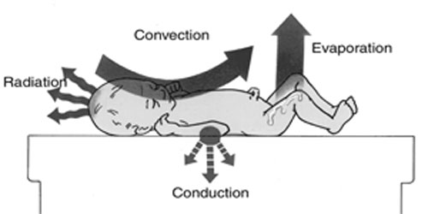
Mechanisms of heat transfer
Heat loss

Slide 10
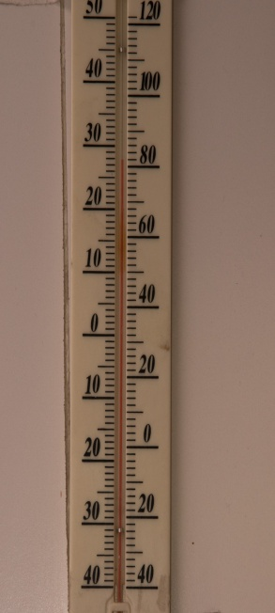
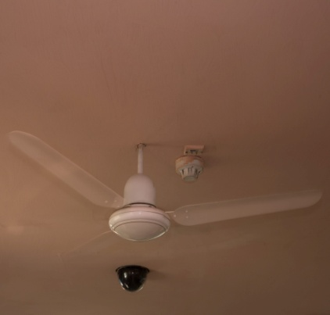
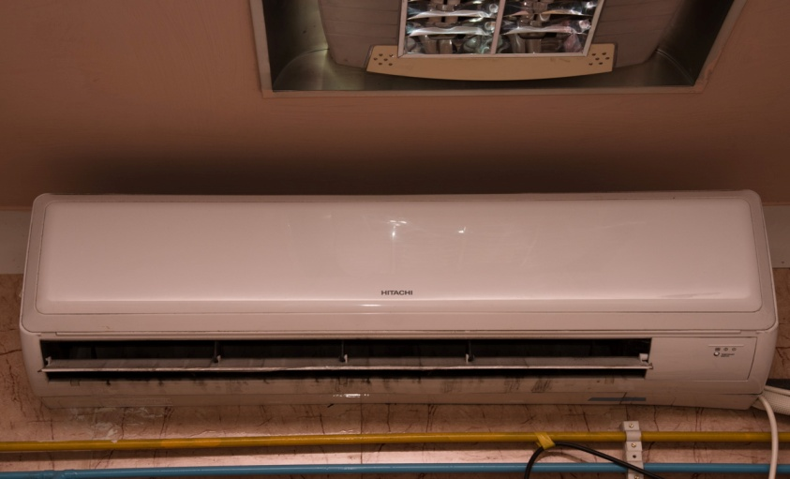
Heat loss by convection
Low room temperatures
Unregulated use of fans and A/Cs

Slide 11
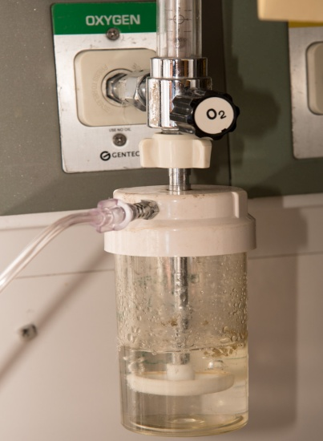
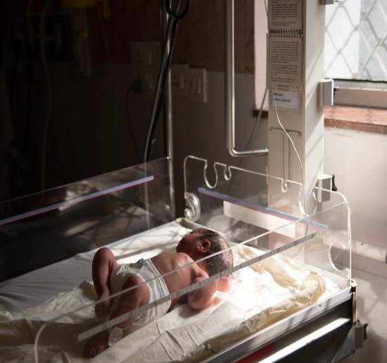
Heat loss by convection
Use of cold medical gases
Keeping the neonate near a open window

Slide 12
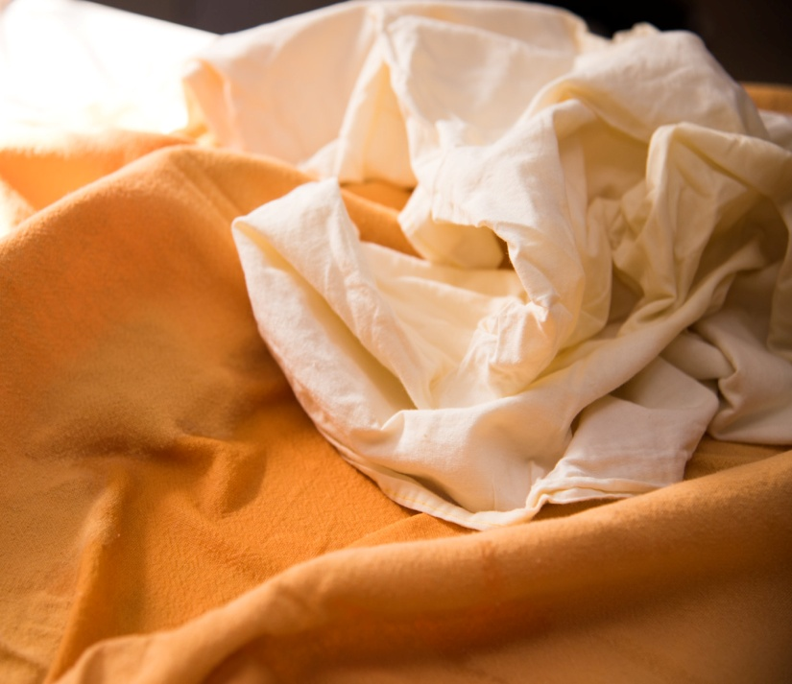
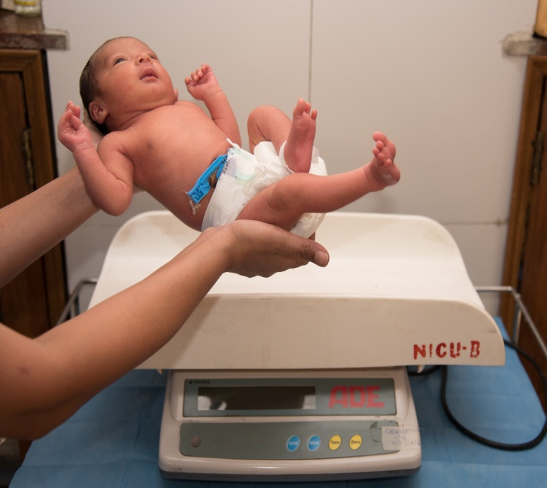
Heat loss by conduction
Use of cold linen at delivery room
Keeping the baby directly on cold surfaces like weight machine and x-ray

Slide 13
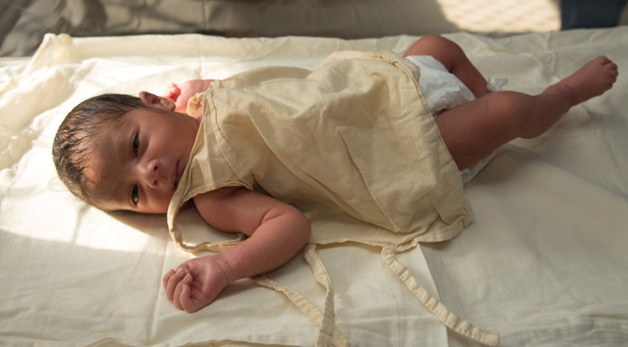
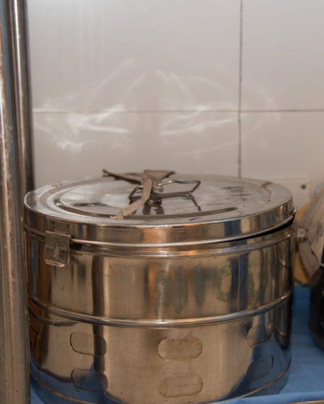
Heat loss by radiation
Nursing the neonate near a cold wall
Inadequate clothing
Too many cold objects in the room

Slide 14
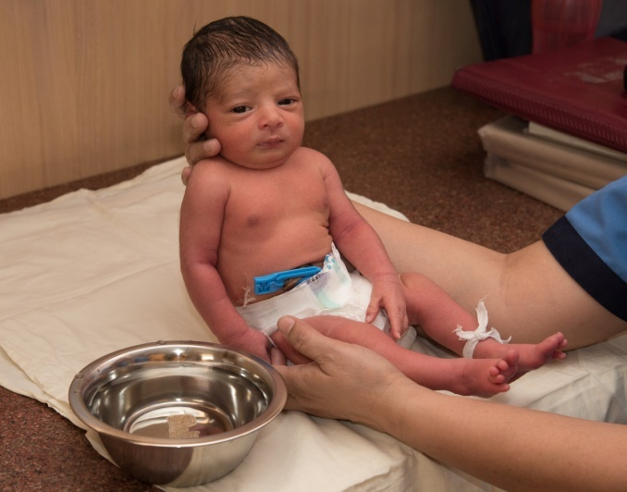

Heat loss by evaporation
Delayed drying at birth
Prolonged contact with wet linen
Frequent bathing
Wet diapers

Slide 15
Why preterms are at higher risk?

Slide 16
Risk factors
Lesser brown fat tissue
Larger surface area per unit kg weight
Skin Immaturity
High transepidermal water loss

Slide 17
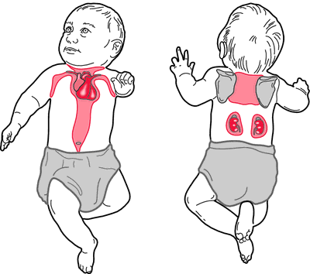
Brown fat
Contributes to 4-10% of fat tissue
Main source of non-shivering thermo genesis
Not detectable before 26-30 weeks of gestation

Slide 18
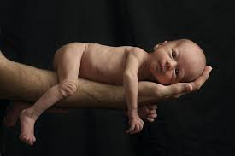
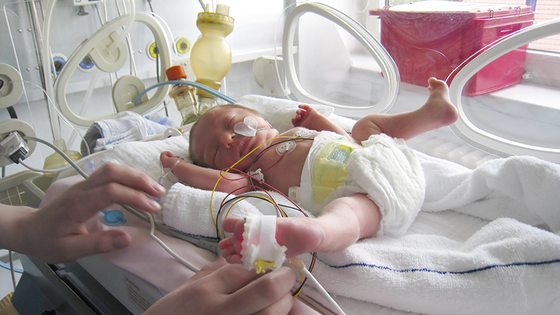
Body surface area
  7 times more per unit (kg) weight compared to adults
  Extended posture will expose more body surface area

Slide 19
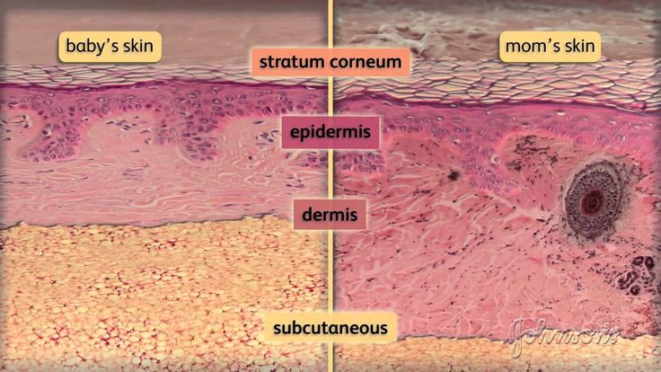
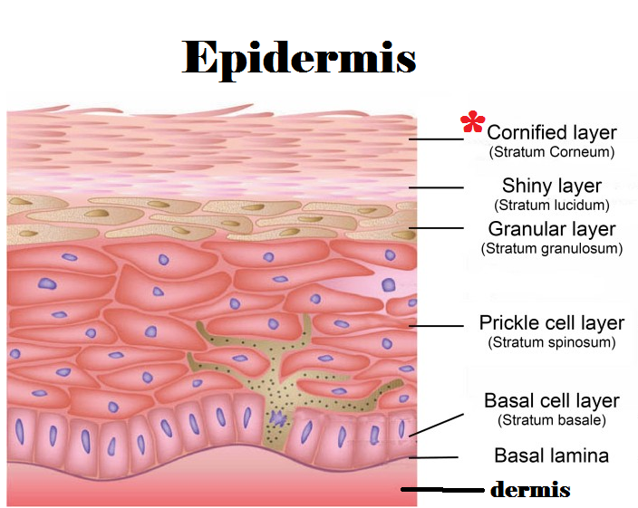
Skin changes
20 to 30% thinner than the adult skin
More thinner epidermis
Less hydrated and has reduced natural moisturization factors
Increased insensible loss of losses
Neonate
Adult

Slide 20
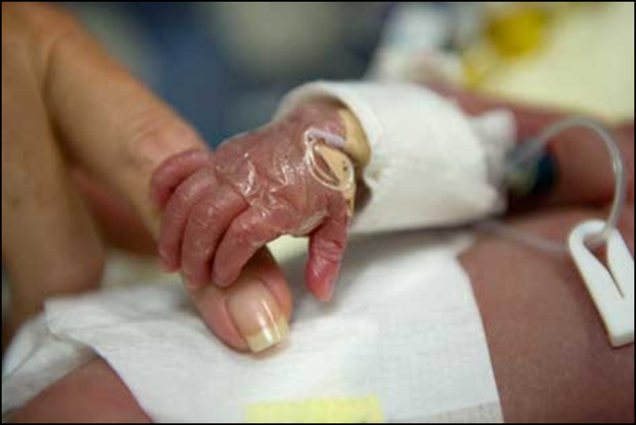
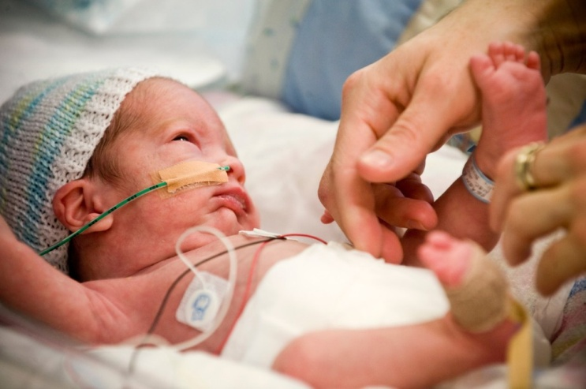
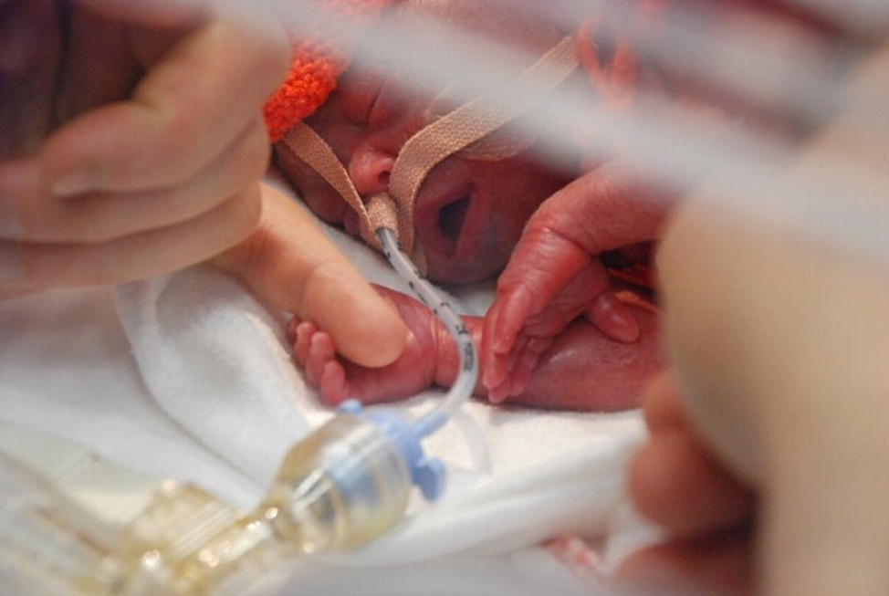
Preterm prone for injuries – Increased insensible loss of water

Slide 21
Key messages
Hypothermia (Temp < 36.5ºC): increased mortality and major morbidities
Ideal environmental temperature is based
  Weight
  Day of life
  Clothing
  Sickness
Thin stratum corneum, increased IWL, larger body surface area and lesser brown fat: Risk factors

